Slide 2
AIUK’s Anti-Death Penalty Project some of the team

Slide 3
WDADP 2024 campaign – The Aim
World Day Against the Death Penalty – 10th October
To engage every US death penalty state governor
To be a persistent advocate for abolition
To counterbalance the pro-DP echo chamber
To nudge all of them towards the abolitionist viewpoint

Slide 4
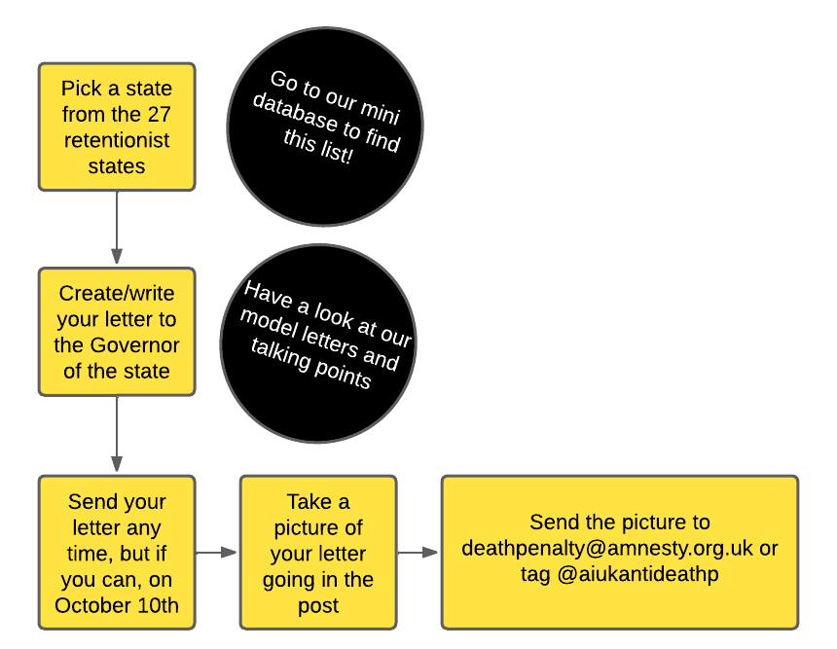
What we want you to do
‘Adopt’ a state
Write your letter
Take a picture
Send your picture to us
Send your letter

Slide 5
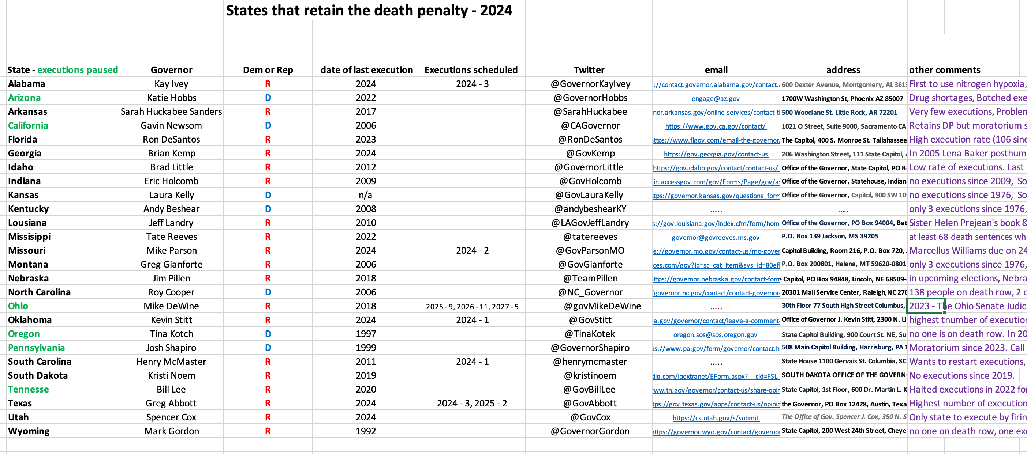
Resources
US state mini-database
Model letters for 2 very different states
Get them here: https://www.amnesty.org.uk/resources/anti-death-penalty-project-usa-special-world-day?

Slide 6
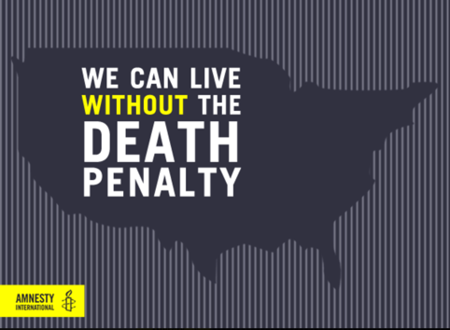
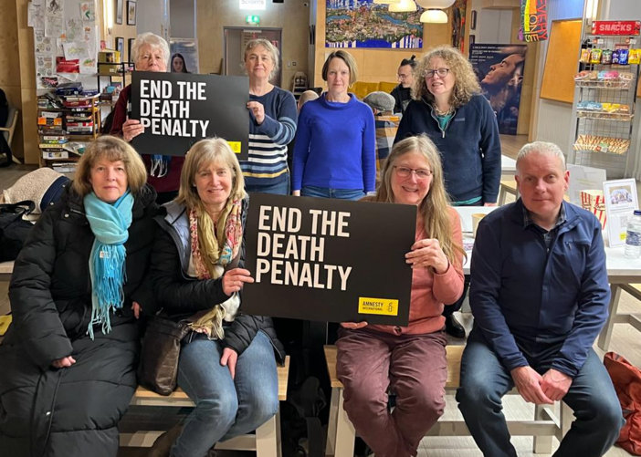
Using social media
Add the hashtag #WorldDayAgainstTheDeathPenalty
Copy in the governor of Ohio @GovMikeDeWine
Please follow the ADPP & tag them into any messages you make - they can repost to amplify the message further.
Twitter/X - @AIUKAntiDeathP
Facebook – search Amnesty Death Penalty Project
Instagram – Anti Death Penalty Project

Slide 7
Using social media

Slide 8
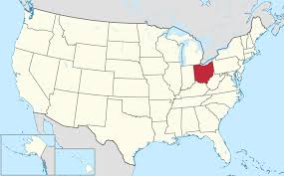
The Reading group has chosen to adopt Ohio!
Please write to any other of the retentionist states if you are interested!
Notes:
Slide 1: The Death Penalty
This presentations on the death penalty is for adult audiences to bring about awareness on the global state of the death penalty in 2017. It will take the audience through Amnesty’s 2016 report on death sentences and executions, cases and Amnesty’s long term commitment to abolishing the death penalty across the world.
The 2017 report on the death penalty can be found here: https://www.amnesty.org/en/documents/act50/5740/2017/en/
You may include the following:
Amnesty International is one of the leading organisations to report on the use of the death penalty across the world.
This presentation will take you through Amnesty’s 2017 report on death sentences and executions, death penalty cases and the impact of Amnesty’s work in this area.
Amnesty’s opposition to the death penalty began as far back as 1965, when it sponsored a UN resolution to suspend and abolish the death penalty for peacetime political offences.
In 1968 Amnesty announced its opposition to the death penalty for political prisoners.
Calls for a total abolition of the death penalty began in 1977, the same year Amnesty was awarded the Nobel Peace Prize.
Amnesty has called on all governments to “bring about the immediate and total abolition of the death penalty”.
Amnesty activists continue to campaign for total abolition of the death penalty in countries across the world.

Slide 9
Reasons to Abolish the Death Penalty
The group brainstormed reasons why we believe the death penalty should be abolished
Racial bias i.e. In Ohio, 55.8% on death row are black people, whereas the black population overall is 13.3%
Also, socio-economic bias - less well qualified defence team available to defendants
Number of exonerations – 11 in Ohio, 10 had corruption within the prosecution process
It’s an expensive process, more so than Life without Parole
Killing is always wrong – if it’s wrong to murder someone, then it’s wrong to execute.
Where it’s normalised within society as the state kills people, it is dehumanising for everyone
It doesn’t work as a deterrent
Doesn’t give closure to families for years as the process is so long
Used as a political tool in many countries, particularly in those which execute most - China, Saudi Arabia, Iran
Convictions frequently based on unsafe evidence – corrupt or unfair systems
Traumatising for wardens overseeing the execution process

Slide 10
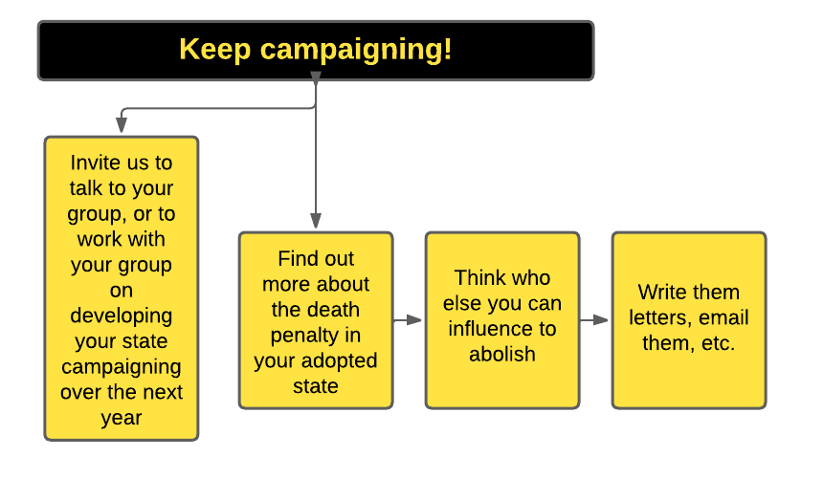
Following up
Here’s a way of involving others
Notes:
Slide 1: The Death Penalty
This presentations on the death penalty is for adult audiences to bring about awareness on the global state of the death penalty in 2017. It will take the audience through Amnesty’s 2016 report on death sentences and executions, cases and Amnesty’s long term commitment to abolishing the death penalty across the world.
The 2017 report on the death penalty can be found here: https://www.amnesty.org/en/documents/act50/5740/2017/en/
You may include the following:
Amnesty International is one of the leading organisations to report on the use of the death penalty across the world.
This presentation will take you through Amnesty’s 2017 report on death sentences and executions, death penalty cases and the impact of Amnesty’s work in this area.
Amnesty’s opposition to the death penalty began as far back as 1965, when it sponsored a UN resolution to suspend and abolish the death penalty for peacetime political offences.
In 1968 Amnesty announced its opposition to the death penalty for political prisoners.
Calls for a total abolition of the death penalty began in 1977, the same year Amnesty was awarded the Nobel Peace Prize.
Amnesty has called on all governments to “bring about the immediate and total abolition of the death penalty”.
Amnesty activists continue to campaign for total abolition of the death penalty in countries across the world.

